Slide 1
TACTIC AI
Adrián Castillo

Slide 2
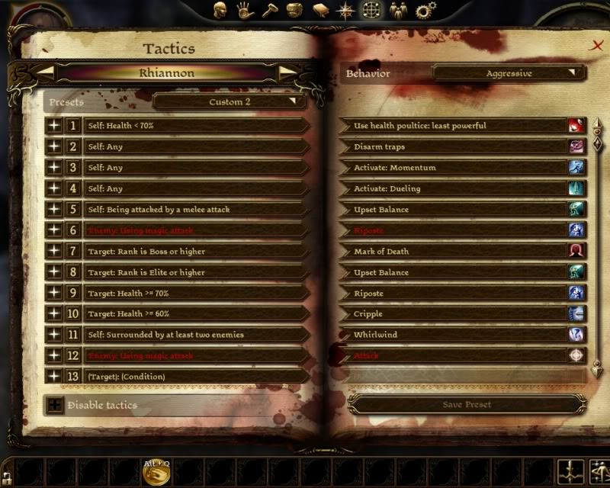
What is tactic AI?
Tactic AI stands for Tactical Artificial Intelligence, but what does that mean?
Dragon Age: Origins

Slide 3
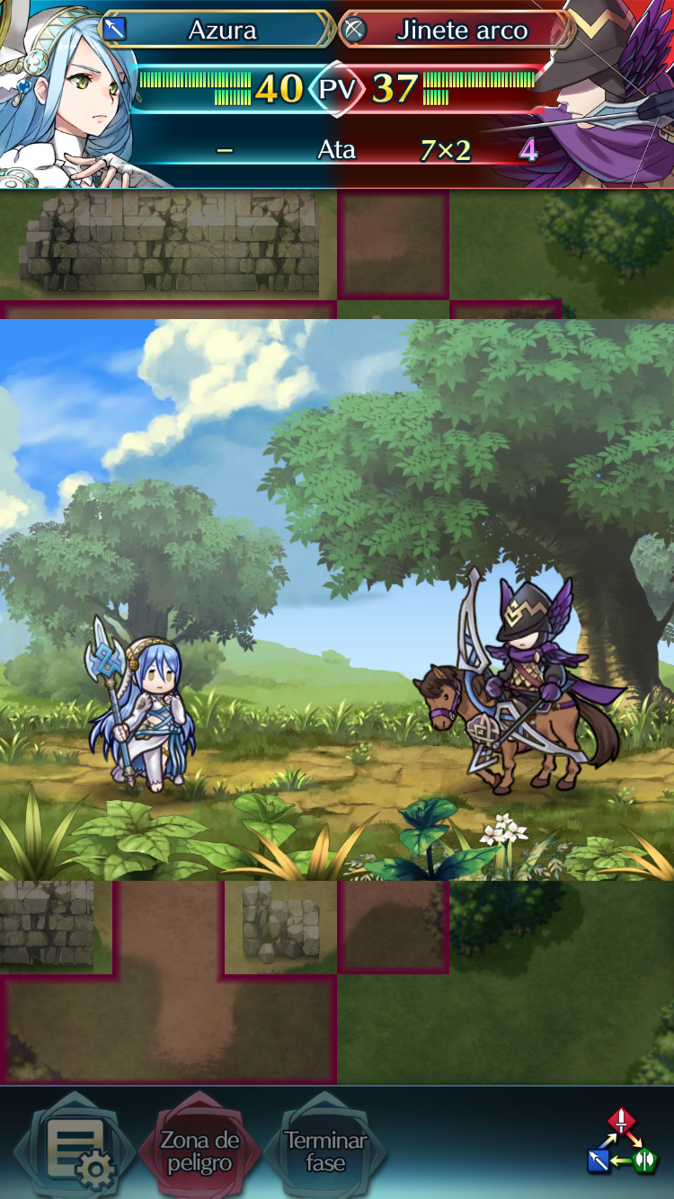
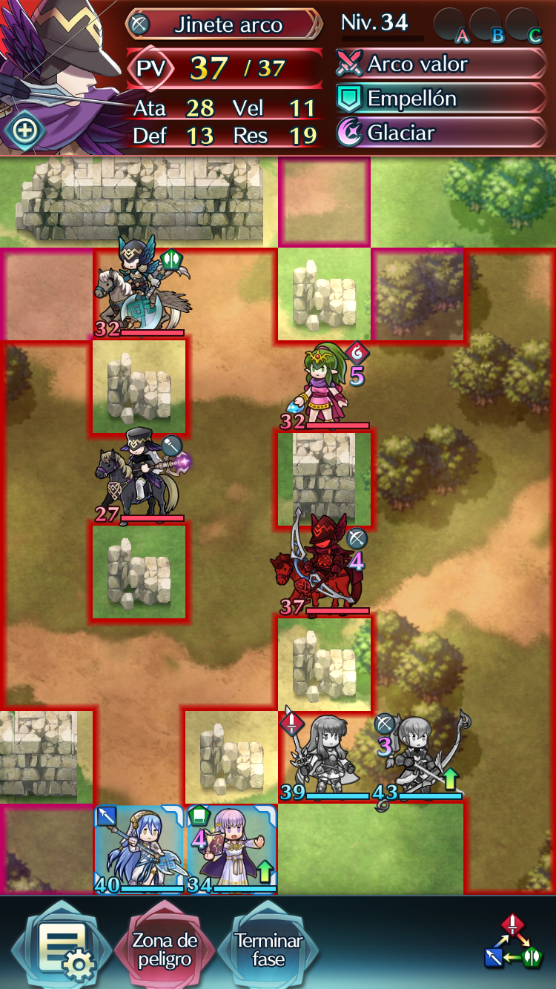
Simple example
If I can kill someone →Attack
Is there a unit who won’t counter attack? → Attack
Enemy with weaker defense → Attack
Fire Emblem: Heroes

Slide 4
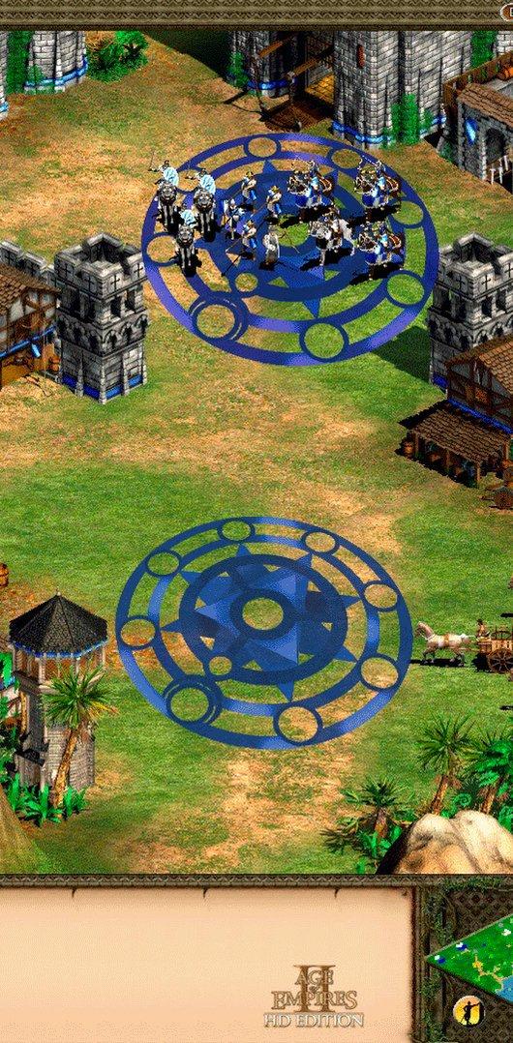
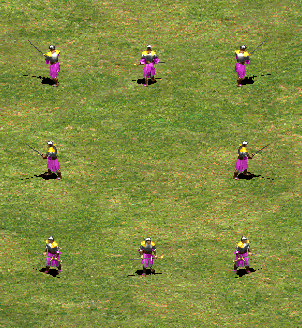
Getting Started
More complex
Harder to program
Impressive result
Easier behaviour
Easier to program
Alright result
Demon Realm Games
Age of Empires II

Slide 5
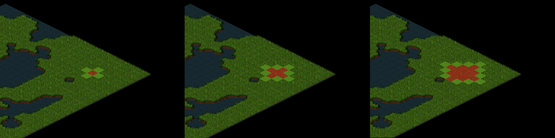
Identifying enemies – Brute Force
We will be using BFS with some tweaks, but it’s expensive when many units are on the field at once.
Radius = 1
Radius = 2
Radius = 3

Slide 6
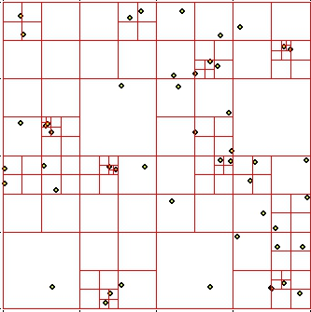
Identifying enemies – The right way
To diminish the use of resources, we should be using a Quadtree search to check units in nodes instead of tiles.

Slide 7
Start the attack
This is the fun part. Once you’ve identified an enemy unit, how does your unit react?

Slide 9

Attacking
Once you’ve gone through all that, it’s time to attack! It should be simple, just reduce the HP of your opponent until he’s dead.

Slide 10

Done!
We’ve covered all the basics… Now it’s time for you to get creative!

Slide 11
TODOs

Slide 12
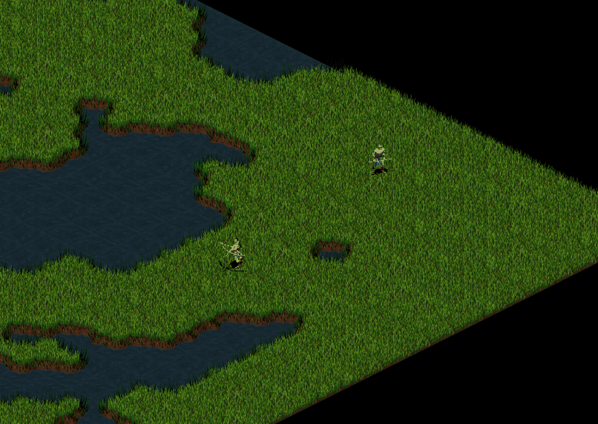
TODO 1
Change BFS to work like this depending on radius – press F1 to see the selected units’ radius.

Slide 13
TODO 2
Check for units in neighbors, and if you find one make it the enemy.

Slide 14
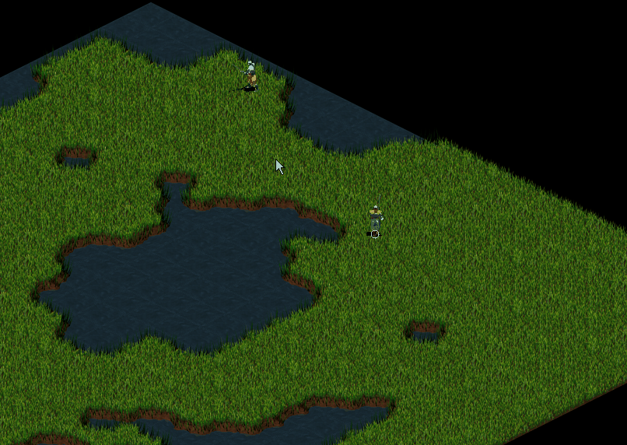
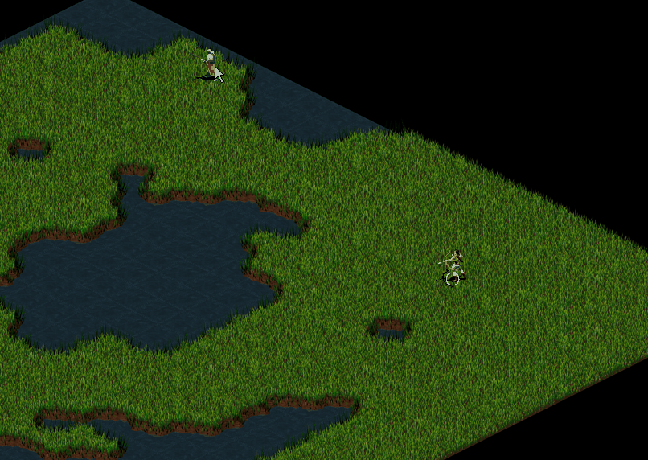
TODO 3
Find the tiles where the unit will fight the enemy and where he’ll fight back. Follow the diagram from before.

Slide 15
TODO 4
Check if the unit can still attack its enemy, and then reduce his HP. If he has moved, repath to him.

Slide 16
TODO 5
Check the unit HP, and delete it if it’s below 0.

Slide 17
EXTRA: TODO 6
Play with the variables! You could make a ranged swordman, or a tanky melee archer.

Slide 18
THANK YOU

